Slide 1

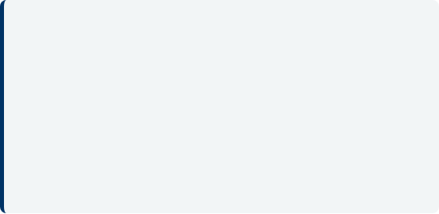
CINEMA SEAT BOOKING SYSTEM
Team Members
Student 1: [2600090188 – BHANU TEJA ]
Student 2: [2600033689 - Hamza]
Student 3: [2600080261 – M. Syavanth]
Student 4: [2600090200 – Shaik owaiz abdullah]
Section: [SECTION 9]
Academic Year: 2026-27
C S B S
Faculty Mentor
Dr D.Anand

Slide 2






Technologies & Concepts Used
Development Stack
Core Java Concepts
Data Structures & Processing
Language: Java
Classes and Objects
Arrays, Loops and
Conditional Statements
Platform: Console-based
Static methods and
modular design
Linear Searching
IDE: Eclipse / IntelliJ / VS Code
Data: In-memory arrays
Input and record
processing
Arrays and object creation
Loops and switch-case

Slide 3
1. Project Overview
A Java console application to manage movie listings and ticket reservations.
Problem Statement
Project Objectives
• Movie details, show timings and bookings need to be managed systematically.
• Manual ticket booking can involve queues and repeated information entry.
• Users need quick movie search, seat-availability information and booking records.
• Add and display movie details.
• Search for a movie by name.
• Book tickets with date and show time.
• Check the available-seat count.
• Simulate payment and support cancellation.
• View booking and generated reports.

Slide 4
2. Users and Functional Modules
The system separates movie, booking and support operations into Java modules.
Admin / Operator
Customer
• Insert movie details
• View the movie list
• Review bookings and reports
• Search for a movie
• Check available seats
• Book or cancel tickets
Core Modules
Support Modules
• Movie Management
• Search Service
• Booking Module
• Availability Service
• Payment Service
• Cancellation Service
• Booking Reports
• Report Generation

Slide 5
3. SDLC Approach for Cinema Booking
A sample lifecycle for planning, building and maintaining the system.
01
Planning
02
Requirements
03
System Design
Define scope, users and project goals.
Identify movie, booking, availability, payment and report requirements.
Design Movie and Booking classes with separate service modules.
04
Implementation
05
Testing
06
Deployment & Maintenance
Implement Java classes, arrays, menu options and service methods.
Test movie search, booking totals, availability and cancellation cases.
Demonstrate the console application and plan future improvements.

Slide 6
4. Requirements Analysis
Functional and quality requirements based on the supplied Java implementation.
Functional Requirements
Quality and Validation Needs
• Movie: enter ID, name, date, show time, price and available seats.
• Search: find a movie by name (case-insensitive).
• Booking: enter booking ID, movie, date, show time and ticket count.
• Payment: select one of five displayed payment methods.
• Cancellation: update booking status and display refund amount.
• Reports: list bookings and generate movie, booking, payment and occupancy reports.
• Use clear menu options and prompts.
• Show a message when a movie or booking is not found.
• Reject payment choices outside the displayed range.
• Keep the code organized into separate static service classes.
• Current version stores records in arrays during execution; persistent storage and stronger input validation are future work.

Slide 7
5. System Architecture / Data Flow
High-level interaction flow for the Java console application.
Movie details
Search / booking
CINEMA SEAT\nBOOKING SYSTEM
ADMIN / OPERATOR
CUSTOMER
Movie Management
Search Service
Booking Module
Availability Service
Payment / Cancel
Reports
Runtime data: Movie[] movies • Booking[] bookings • movieCount • bookingCount

Slide 8
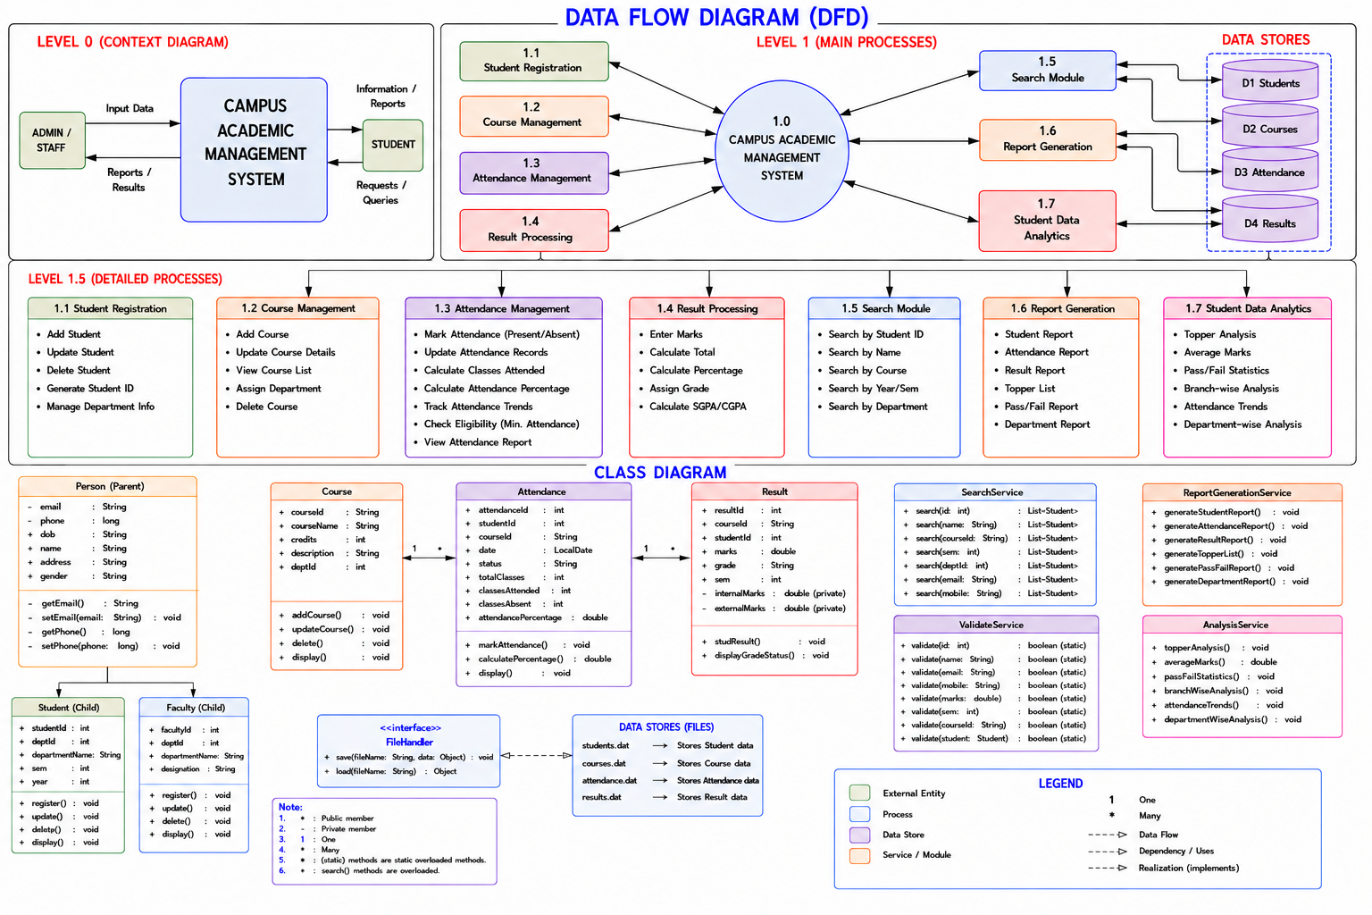
6. Class Design
Core classes and service methods are based on the submitted Java source.
Movie
movieId • movieName • date
showTime • ticketPrice • availableSeats
Booking
bookingId • movieName • date
showTime • numberOfTickets • totalPrice • status
CinemaSeatBookingSystem
movies[] • bookings[]
movieCount • bookingCount • main()
SearchService
searchMovie()
AvailabilityService
checkAvailability()
Payment & Cancellation
payment(amount)
cancelTicket()
ReportService
viewAllBookings()
ReportGenerationService
Movie • Booking • Payment • Occupancy

Slide 9
7. Data Management
The submitted version uses fixed-size arrays held in memory while the program runs.
Structure
Information held
Used in
Movie[] movies
Movie details and seat count
Movie Management / Search
Booking[] bookings
Booking and payment summary
Booking / Cancellation
movieCount
Number of movies currently stored
Movie listing / Reports
bookingCount
Number of bookings currently stored
Booking reports / Occupancy
Note: No database or file-persistence layer is implemented in the supplied code. Records reset when the program ends.

Slide 10
8. Testing Strategy
Representative test cases for the supplied Cinema Seat Booking System.
Add movie
Enter movie ID, name, date, time, price and seats
Movie details are stored and success message appears
Movie search
Search for an existing and a missing movie name
Movie details displayed or “Movie not found.”
Ticket booking
Enter booking details and ticket quantity
Total is calculated using Rs. 180 per ticket
Seat availability
Enter a movie name already in the movie list
Available-seat count is displayed
Payment / cancellation
Try valid/invalid payment choice and existing/missing booking ID
Success, invalid-choice or booking-not-found message
Report generation
Generate movie, booking, payment and occupancy reports
Report displays records and calculated booked-ticket totals

Slide 11
9. Expected Outcomes and Future Enhancements
Expected benefits and practical next steps for the current console prototype.
Expected Outcomes
Possible Future Enhancements
• Manage movie details from one menu.
• Search movie records by name.
• Record ticket bookings and totals.
• View availability and booking status.
• Display reports for movies, bookings, payments and occupancy.
• Connect a database for permanent records.
• Reduce available seats after each confirmed booking.
• Validate inputs and prevent duplicate booking IDs.
• Integrate a real payment gateway and refund workflow.
• Build a GUI / web or mobile interface and notifications.

Slide 12
10. Sample Outputs
1. Main Menu and Movie Entry
MAIN MENU / INSERT MOVIE
===== CINEMA SEAT BOOKING SYSTEM =====
1. Insert Movie 2. View All Movies 3. Find Movie
4. Book Ticket 5. Check Seat Availability
6. Payment 7. Cancel Ticket 8. View All Bookings
9. Exit
Enter Movie ID: 101
Enter Movie Name: Interstellar
Enter Date: 02-11-2026
Enter Show Time: 06:30 PM
Enter Ticket Price: 180
Enter Available Seats: 45
Movie added successfully.

Slide 13
2. Movie Search
Illustrative console output; values are sample data, not captured execution screenshots.
2. Movie Search
Enter Movie Name to Search: Interstellar
Movie ID: 101
Movie Name: Interstellar
Date: 02-11-2026
Show Time: 06:30 PM
Ticket Price: 180
Available Seats: 45

Slide 14
3. Ticket Booking
Illustrative console output; values are sample data, not captured execution screenshots.
3. Ticket Booking
Enter Booking ID: 501
Enter Movie Name: Interstellar
Enter Date: 02-11-2026
Enter Show Time: 06:30 PM
Enter Number of Tickets: 2
Ticket booked successfully.
Total Price: Rs. 360

Slide 15
4. Seat Availability
Illustrative console output; values are sample data, not captured execution screenshots.
4. Seat Availability
Enter Movie Name: Interstellar
Available Seats: 45
Would you like to proceed?

Slide 16
5. Payment
Illustrative console output; values are sample data, not captured execution screenshots.
5. Payment
===== PAYMENT =====
1. Net Banking
2. Debit Card
3. Credit Card
4. PhonePe
5. Google Pay
Select Payment Method: 4
Payment of 360 successful.

Slide 17
6. Ticket Cancellation
Illustrative console output; values are sample data, not captured execution screenshots.
6. Ticket Cancellation
Enter Booking ID: 501
Ticket cancelled successfully.
Refund Amount: 360

Slide 18
7. Booking Report
Illustrative console output; values are sample data, not captured execution screenshots.
7. Booking Report
Booking ID: 501
Movie Name: Interstellar
Date: 02-11-2026
Show Time: 06:30 PM
Number of Tickets: 2
Total Price: 360
Status: Booked

Slide 19
8. Report Generation
Illustrative console output; values are sample data, not captured execution screenshots.
8. Report Generation
===== MOVIE DETAILS REPORT =====
Interstellar | 02-11-2026 | 06:30 PM
===== TICKET BOOKING REPORT =====
Booking ID: 501 | Tickets: 2 | Amount: Rs. 360
===== THEATRE OCCUPANCY REPORT =====
Booked Tickets: 2 | Available Seats: 45

Slide 20
9. Exit
Illustrative console output; values are sample data, not captured execution screenshots.
9. Exit
===== CINEMA SEAT BOOKING SYSTEM =====
1. Insert Movie
2. View All Movies
3. Find Movie
4. Book Ticket
5. Check Seat Availability
6. Payment
7. Cancel Ticket
8. View All Bookings
9. Exit
Thank you for using Cinema Seat Booking System.

Slide 21
FRONT END WEB PAGE CODE
<!DOCTYPE html>
<html lang="en">
<head>
<meta charset="UTF-8">
<meta name="viewport" content="width=device-width, initial-scale=1.0">
<title>Cinema Ticket Booking</title>
<style>
body { font-family: Arial, sans-serif; background: #1a1a24; color: #fff; text-align: center; padding: 20px; }
.movie-select { margin-bottom: 20px; }
select { padding: 8px; font-size: 16px; border-radius: 5px; }
.screen { background: #e50914; height: 15px; width: 200px; margin: 15px auto; border-radius: 5px; box-shadow: 0 0 10px #e50914; }
.seats { display: grid; grid-template-columns: repeat(4, 40px); gap: 10px; justify-content: center; margin: 20px 0; }
.seat { width: 40px; height: 40px; background: #444; border-radius: 5px; cursor: pointer; line-height: 40px; font-size: 12px; }
.seat.selected { background: #e50914; }
.seat.occupied { background: #222; cursor: not-allowed; color: #666; }
button { background: #e50914; color: white; border: none; padding: 10px 20px; border-radius: 5px; cursor: pointer; font-size: 16px; }
button:hover { background: #b80710; }
</style>
</head>

Slide 22
<body>
<h1>Cinema Ticket Booking</h1>
<div class="movie-select">
<label>Select Movie: </label>
<select id="movie">
<option value="12">Cyberpunk 2077 ($12)</option>
<option value="10">Space Odyssey ($10)</option>
<option value="15">The Matrix ($15)</option>
</select>
</div>
<div class="screen"></div>
<p><small>SCREEN</small></p>
<div class="seats" id="seatContainer">
<div class="seat">A1</div>
<div class="seat">A2</div>
<div class="seat occupied">A3</div>
<div class="seat occupied">A4</div>
<div class="seat">B1</div>
<div class="seat">B2</div>
<div class="seat">B3</div>
<div class="seat">B4</div>

Slide 23
</div>
<p>Selected Seats: <span id="count">0</span> | Total: $<span id="total">0</span></p>
<button onclick="bookTicket()">Confirm Booking</button>
<script>
const seats = document.querySelectorAll('.seat:not(.occupied)');
const count = document.getElementById('count');
const total = document.getElementById('total');
const movieSelect = document.getElementById('movie');
function updateSummary() {
const selectedSeats = document.querySelectorAll('.seat.selected');
const selectedCount = selectedSeats.length;
count.innerText = selectedCount;
total.innerText = selectedCount * movieSelect.value;
}
seats.forEach(seat => {
seat.addEventListener('click', () => {
seat.classList.toggle('selected');
updateSummary();

Slide 24
});
});
movieSelect.addEventListener('change', updateSummary);
function bookTicket() {
const selectedCount = document.querySelectorAll('.seat.selected').length;
if (selectedCount === 0) {
alert('Please select at least one seat.');
} else {
alert(`Successfully booked ${selectedCount} ticket(s) for $${total.innerText}!`);
}
}
</script>
</body>
</html>

Slide 25


THANK YOU
CINEMA SEAT BOOKING SYSTEM
Questions & Answers

